Slide 1
Desenvolvimento de aplicações em QGIS para modelos de gestão de risco QGIS applications development for risk models
Lia DUARTE*^{1,2}, Ana Cláudia TEODORO^{1,2}, José Alberto GONÇALVES^{2,3}
¹ Instituto Ciências da Terra (ICT); Polo FCUP
²Departamento de Geociências, Ambiente e Ordenamento do Território, FCUP
³ CIIMAR, Universidade do Porto
³ (*liaduarte@fc.up.pt; amteodor@fc.up.pt; jagoncal@fc.up.pt)

Slide 2
OUTLINE
Introduction
Objectives
Methodology
DRASTIC Application
RUSLE Application
Desktop version
WEB version
Results and Discussion
Conclusions

Slide 3
Introduction – Groundwater vulnerability
Foster (1987), employs the expression “aquifer pollution vulnerability” to represent the intrinsic characteristics which determine the sensitivity of the groundwater system to being adversely affected by an imposed pollutant load.
NAP (1993), defines groundwater vulnerability to pollution as the tendency or likelihood for pollutants to reach a specified position in the groundwater system after introduction at some location above the uppermost aquifer.
Notes:
A National Academy Press (NAP, 1993) define a vulnerabilidade à poluição da água subterrânea como a tendência ou possibilidade de os poluentes atingirem uma determinada localização no sistema aquífero depois de introduzidos acima do nível aquífero superficial

Slide 4
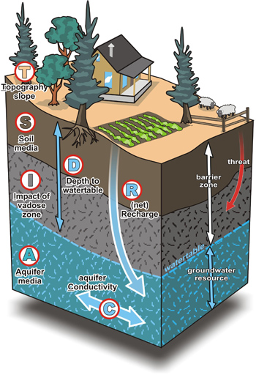
DRASTIC – groundwater vulnerability
DRASTIC index is composed by seven parameters and it is a result of weighted average of these seven values.
D – Depth to Groundwater
R – Net Recharge
A – Aquifer Media i-index
S – Soil Media p-weight
T – Topography
I – Impact of Vadose Zone
C – Hydraulic Conductivity
DRASTIC = Dp × Di + Rp × Ri + Ap × Ai + Sp × Si + Tp× Ti + Ip × Ii + Cp × Ci
Notes:
D - Profundidade da zona não saturada
R - Recarga do aquífero
A - Material do aquífero
S - Tipo de solo
T - Topografia
I - Impacto na zona não saturada
C - Condutividade hidráulica do aquífero

Slide 5
Introduction – Soil erosion
Considered a serious and major environmental problem in many parts of the world, endangering areas such as agriculture, environment, natural resources, flooding and habitat destruction
Soil erosion consists in the detachments of individual soil particles from the soil mass which are transported by erosive agents, such as water or wind

Slide 6
Soil erosion
Precise knowledge of erosion risk
Environmental and economics consequences
Dificulte to obtain and estimate
Define policies and prevention measures on water and soil resource conservation

Slide 7
Factors that induce soil erosion
Natural
Soil degradation
Water quality
Hydrogeological systems
Agricultural production
Vegetation cover
Topographic features
Climatic variables
Soil characteristics
Slope
Precipitation
Human
Agriculture activity

Slide 8
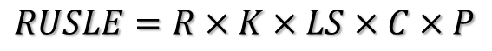
RUSLE – Revised Universal Soil Loss Equation
Control soil erosion
Assess soil erosion risk
Estimate soil erosion loss
R (rainfall erosivity factor)
K (soil erodibility factor)
LS (Slope Length factor)
C (cover management factor)
P (conservation practice factor)
$$RUSLE=R×K×LS×C×P$$

Slide 9
Geographic Information System (GIS)
GIS are often combined with soil erosion models as an effective approach to estimate the magnitude and distribution of erosion
GIS provide powerful tools in modelling geospatial information
Several studies have been developed to assess soil erosion and to estimate groundwater vulnerability through GIS proprietary software, using RUSLE method and DRASTIC method, respectively
There isn’t a tool adapted to anymodel which can be modified and freely used

Slide 10
Objective of DRASTIC Model
Application DRASTIC
Software open source, free, easy and intuitive
Create groundwater vulnerability maps
Possibility of modifying the code
DRASTIC method
Manipulation of complex variables with different information and parameters

Slide 11
Objective of RUSLE Model
Application RUSLE Desktop
Software open source, free, easy and intuitive
Create soil erosion risk maps
Possibility of modifying the code
RUSLE method
Manipulation of complex variables with different information and parameters
WEB Page
Create and visualize erosion maps
Without the need of GIS environment
RUSLE WEB

Slide 12
Methodology
Software QGIS
APIs (Aplication Programming Interface): Numpy, SAGA, QGIS API, Gdal/OGR API, PyQt4 API
Processing Toolbox algorithms (QGIS): ordinarykrigingglobal, clipgridwithpolygon, cubicsplineapproximation, r.mapcalculator, v.surf.idw e v.surf.rst
Python programming language
Framework Django (RUSLE WEB version)

Slide 13
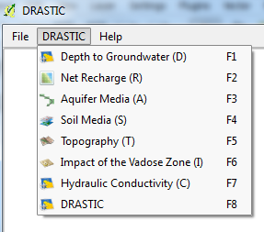
DRASTIC Application
DRASTIC Window
Map canvas
Menu Bar
File menu
DRASTIC menu
Help menu

Slide 14
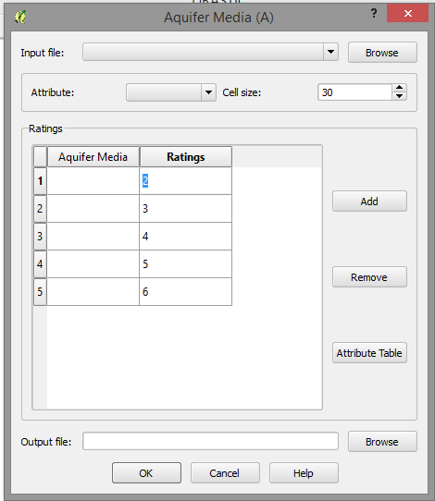
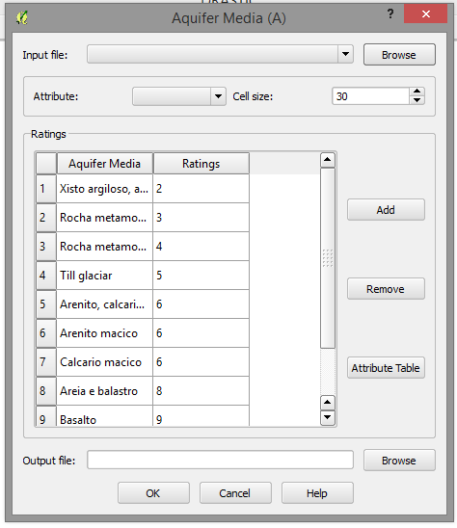

DRASTIC Application

Slide 15
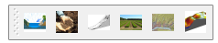
RUSLE Desktop Version
R LS P
K C RUSLE final

Slide 16
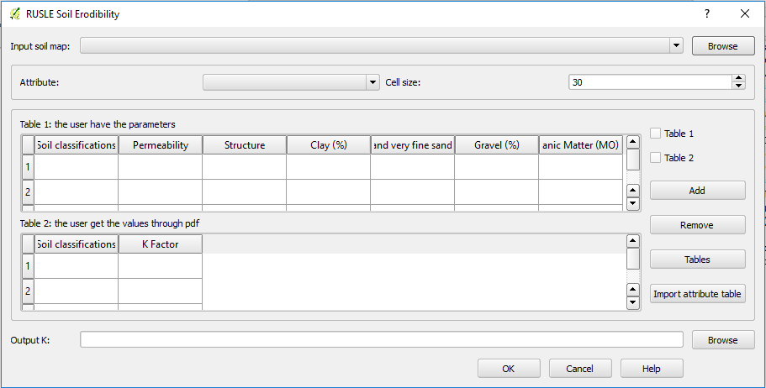
RUSLE Desktop Version

Slide 17
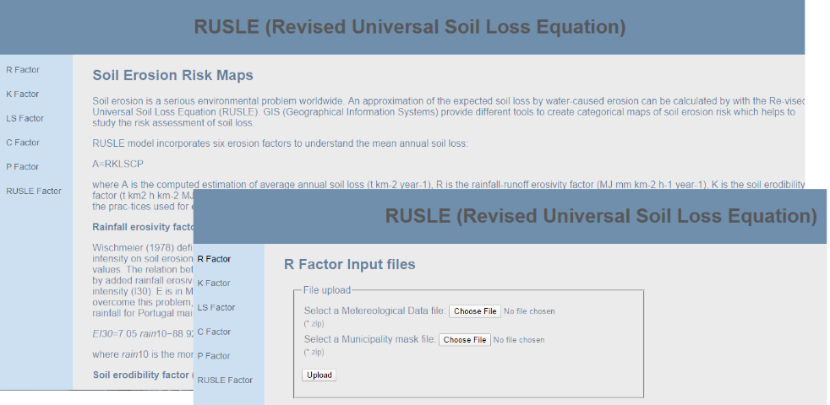
RUSLE WEB Version

Slide 18
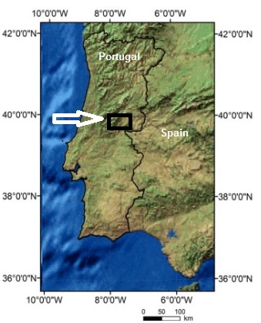
Results – DRASTIC: Case study Castelo Branco, Portugal
Tagus basin, near to Castelo Branco city, Portugal.
Groundwater system covers approximately 1500 hectares with a maximum depth of 35 meters.
Spatial resolution: 20 meters.
ETRS89 PTTM06 coordinate system.

Slide 19
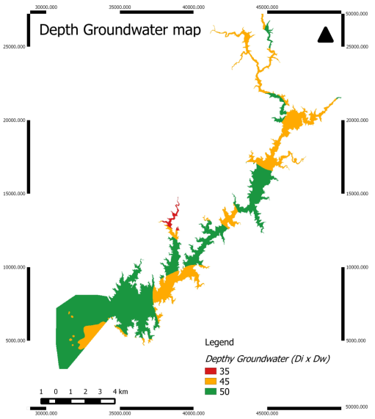
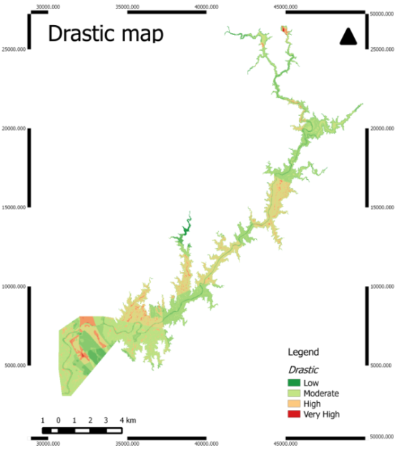
Results – DRASTIC: Case study Castelo Branco - Portugal

Slide 20
Results – RUSLE: Case study Montalegre
Covers approximately 80,580 hectares
Atlantic climate
High precipitation occurrence (1531 mm/year)
High slope carries high erosion risks when soil protection measures are not taken
The spatial resolution of the raster files used in this study case was defined as 20 meters.
The data were in the ETRS89 PT-TM06 coordinate reference system (EPSG:3763).

Slide 21
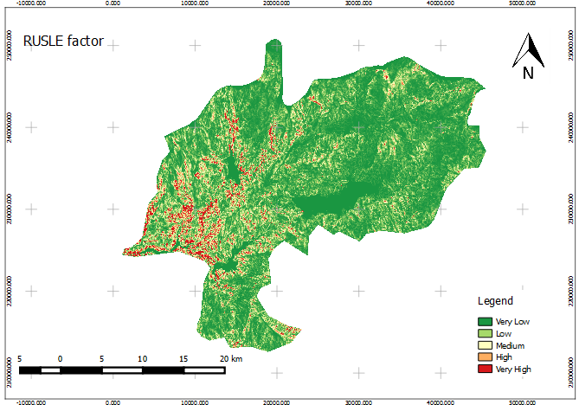
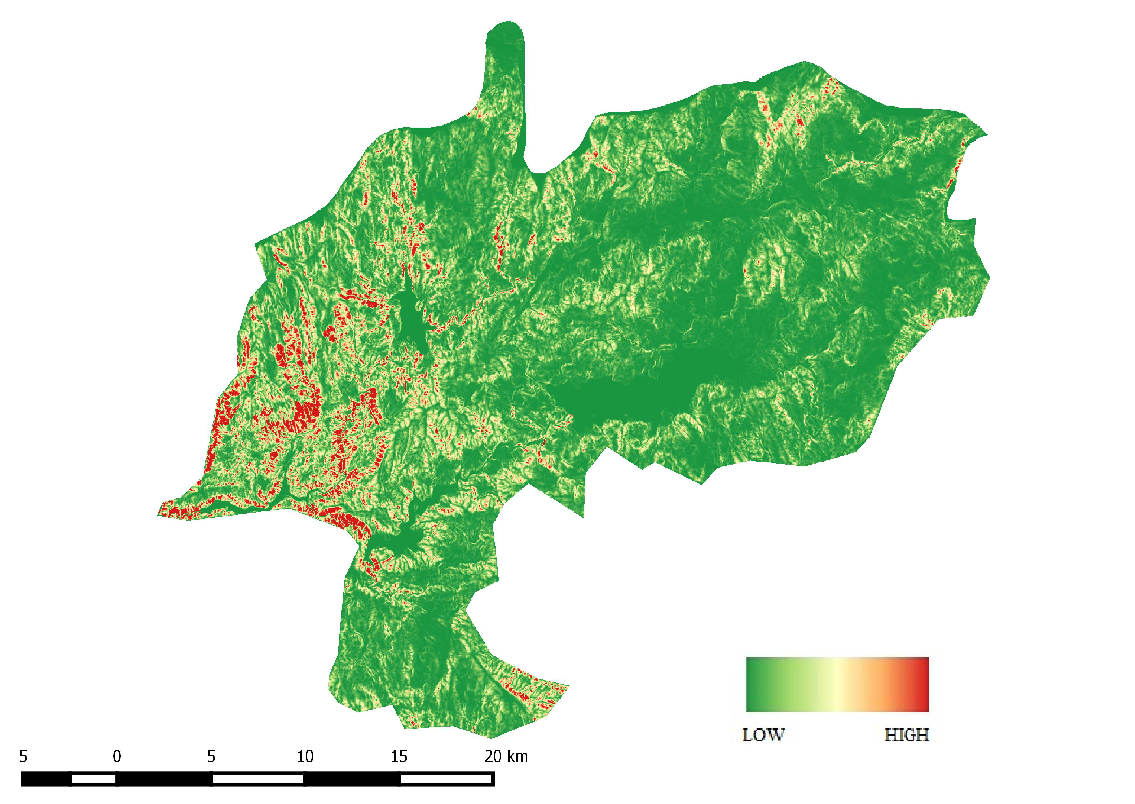
Results – RUSLE: DESKTOP and WEB RUSLE map

Slide 22
Discussion
DRASTIC
The DRASTIC index values vary between 100 and 181.
The available data were not enough to evaluate more precisely the groundwater vulnerability.
The DRASTIC index was obtained based in data available and based in Aller et al. (1987) DRASTIC model.
The DRASTIC index was created in the 80’s of the last century. However, this index is worldwide used for the hydrologist’s community.
RUSLE
29 % of the area is characterized by very low soil erosion level
8 % as very high to soil erosion
4 % of the total area are characterized with very high slope values along with very high soil erosion level.
Areas with high slope values are related with high level of erosion.
Although a large part of the study area is classified with zones as low levels of erosion, high slope values and high values of precipitation are typical of Montalegre municipality, so it stands to reasonable values classified with very high levels of erosion.
The C factor is higher in zones where the soil erosion level is lower. So in these areas the soil is more protected.

Slide 23
Conclusions – DRASTIC Application main advantages
Generating several procedures, giving the possibility of analyzing and change the final map.
DRASTIC - Net Recharge presents two different methods to generate the result.
Easiness and quickness to produce maps.
Change the indexes and weights until get the better interpretation to his study area.
Open source software makes it easier to obtain and use

Slide 24
RUSLE desktop application
Vantages
Provides the possibility of moving the C factor map in order to evaluate if the value helps to control the erosion.
Disadvantages
Creates the maps without the layout composer.
It is flexible and allows to simulate the fact before.
It is more detailed given several options and parameters options to the user.
With the possibility to import the input shapefile attribute table, the user can easily adapt to other case studies.
In some factors, such as K factor, the user can choose between two methods in order to obtain the final map. If the user has access to field observations of the soil parameters he/she can adapt the K factor map to his/her field knowledge.
Requires GIS software knowledge.
The desktop application allowed to upload different tabulated data in pdf format.

Slide 25
RUSLE WEB application
Vantages
Generates the maps and incorporates a layout with a scale bar and the legend with the colours defined in high and low values.
Disadvantages
The user must define the parameters in shapefile attribute table first.
It is a website where any user can upload the input files necessary to calculate each RUSLE factor and to obtain the final RUSLE map in a few minutes.
It is not necessary to have a GIS software installed and the user doesn’t need to know GIS algorithms or tools.
The maps creation depends on the internet connectivity.

Slide 26
Conclusions - RUSLE
There are some differences between the two applications, although the two of them presents a very good performance in creating the maps.
The model implemented is adapted for Portugal and uses the pdf tables defined by Pimenta (1998). However, this model can be adapted to other countries or regions if other tables were incorporated.
The two versions developed can be very useful to create the maps necessary to evaluate soil erosion in certain zones.
The two versions are freely available.

Slide 27
Thanks for your attention! Desenvolvimento de aplicações em QGIS para modelos de gestão de risco QGIS applications development for risk models
Lia DUARTE*^{1,2}, Ana Cláudia TEODORO^{1,2}, José Alberto GONÇALVES^{2,3}
¹ Instituto Ciências da Terra (ICT); Polo FCUP
²Departamento de Geociências, Ambiente e Ordenamento do Território, FCUP
³ CIIMAR, Universidade do Porto
³ (*liaduarte@fc.up.pt; amteodor@fc.up.pt; jagoncal@fc.up.pt)

